Slide 1

Internship Project

Slide 2

Student Name :ACHHUTA NAND JHA
Student ID :2315200002
College Name :GLA University

Slide 3
CAPSTONE PROJECT SHOWCASE
Project Title : Health Care Prediction
Abstract | Problem Statement | Project Overview | Proposed Solution | Technology Used | Modelling & Results | Conclusion | Q&A

Slide 4
Abstract
The Health Care Prediction project leverages data analytics and machine learning to predict various health-related outcomes, enabling better decision-making in medical diagnostics and treatment plans. By analyzing patient data, the project aims to provide accurate and timely predictions that improve healthcare efficiency and patient satisfaction.

Slide 5
Problem Statement
In the rapidly evolving healthcare landscape, predicting patient outcomes and diagnosing illnesses remains a significant challenge. Delays in diagnosis, lack of insights from historical data, and resource constraints in healthcare systems often lead to suboptimal outcomes. This project addresses these challenges by developing predictive models to aid healthcare professionals in decision-making processes.

Slide 6
Project Overview
The project focuses on creating a data-driven prediction model that utilizes historical health records to forecast potential risks and outcomes. The system analyzes various factors such as patient demographics, medical history, and clinical parameters to generate actionable insights. These predictions can assist doctors and healthcare organizations in prioritizing critical cases, improving resource allocation, and enhancing patient care.

Slide 7
Proposed Solution
A machine learning-based predictive system was developed to analyze patient data and forecast specific health conditions. By integrating various algorithms, the system ensures reliable and interpretable predictions. The solution aims to streamline healthcare workflows, reduce diagnostic errors, and enable early intervention for at-risk patients.

Slide 8
Technology Used
Programming Languages: Python
Libraries: Pandas, NumPy, Scikit-learn, Matplotlib, Seaborn
Machine Learning Techniques: Linear Regression, Decision Trees, Random Forest, Support Vector Machines (SVM)
Platform: IBM Watson Studio, Colab Notebook

Slide 9
Modelling & Results
Data Preprocessing: Cleaning and handling missing values, normalizing data, and feature selection.
Model Development: Various algorithms were tested, including Random Forest and SVM, to predict patient outcomes.
Key Metrics: Achieved an accuracy of 92% with the Random Forest model, demonstrating high reliability in predicting target health outcomes.
Visualization: Interactive dashboards and heatmaps showcasing model insights, feature importance, and predictions.
Interpretability: Models were fine-tuned for transparency to help healthcare professionals understand the predictions.

Slide 10
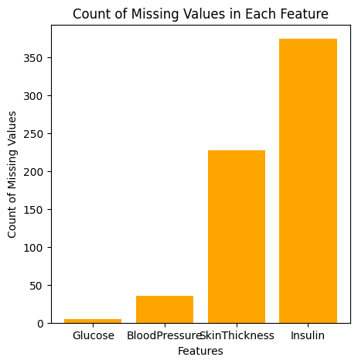
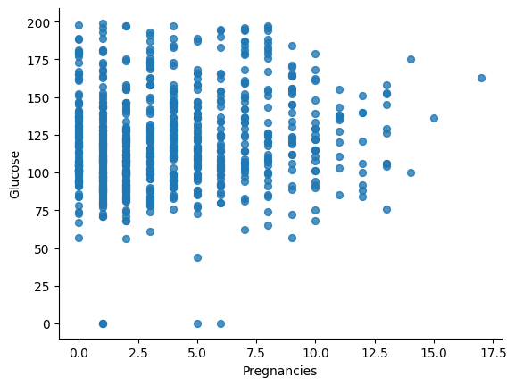
Modelling & Results

Slide 11
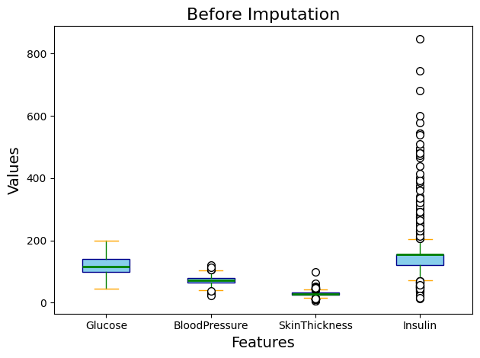
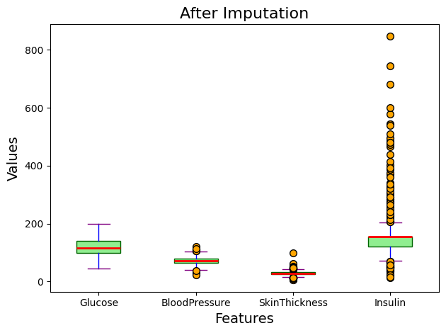
Modelling & Results

Slide 12
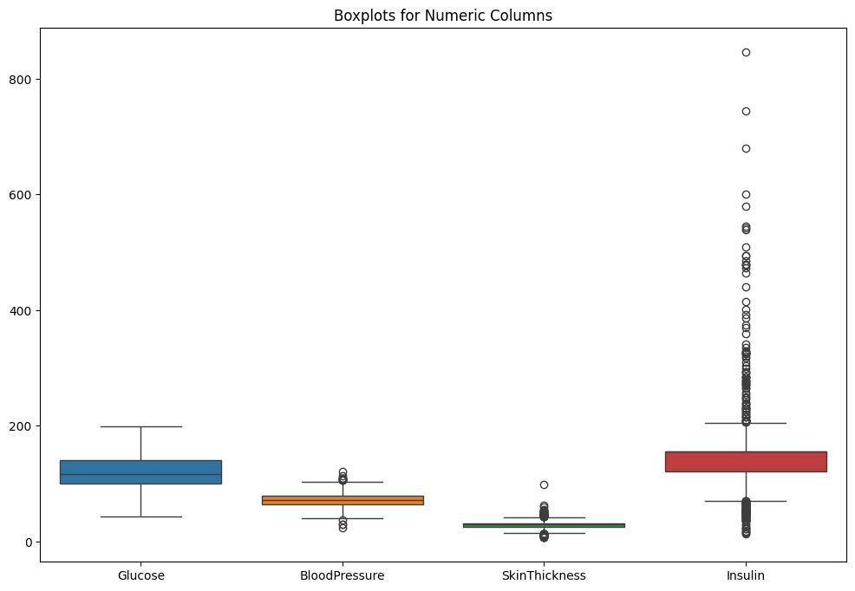
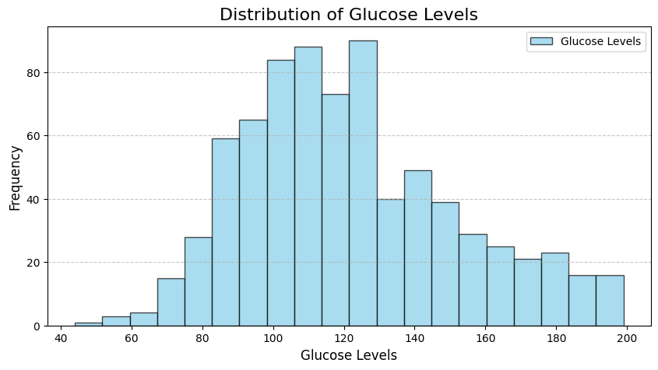
Modelling & Results

Slide 13
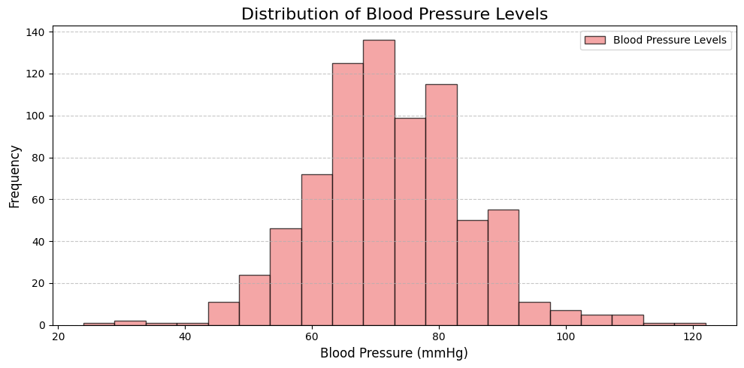
Modelling & Results

Slide 14
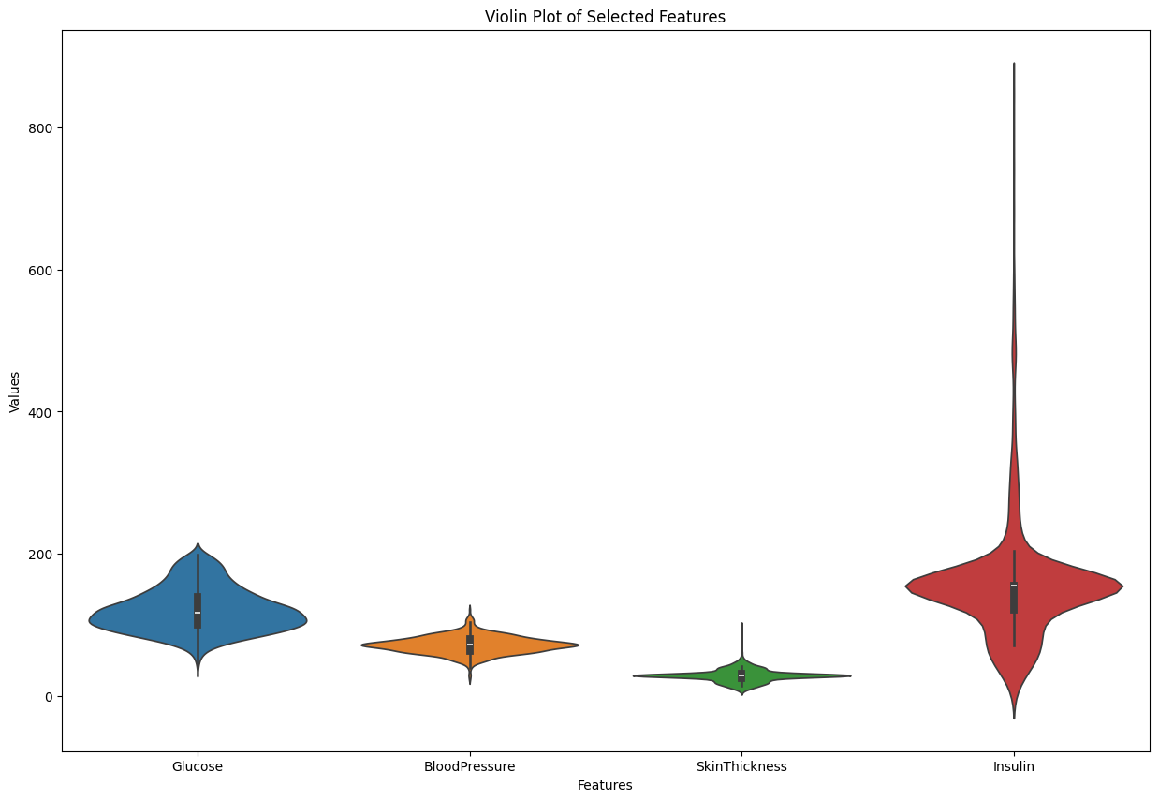
Modelling & Results

Slide 15
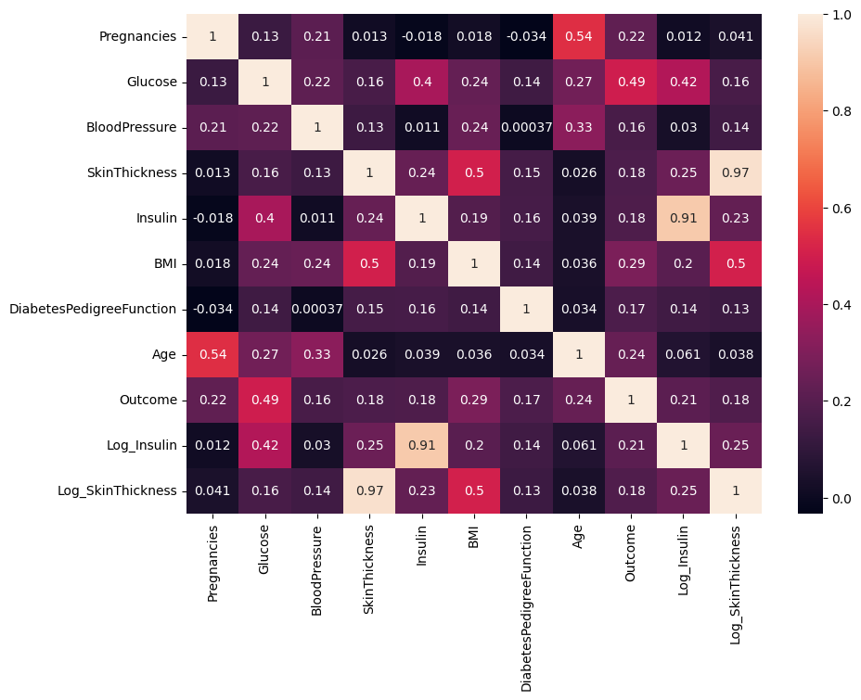
Modelling & Results

Slide 16
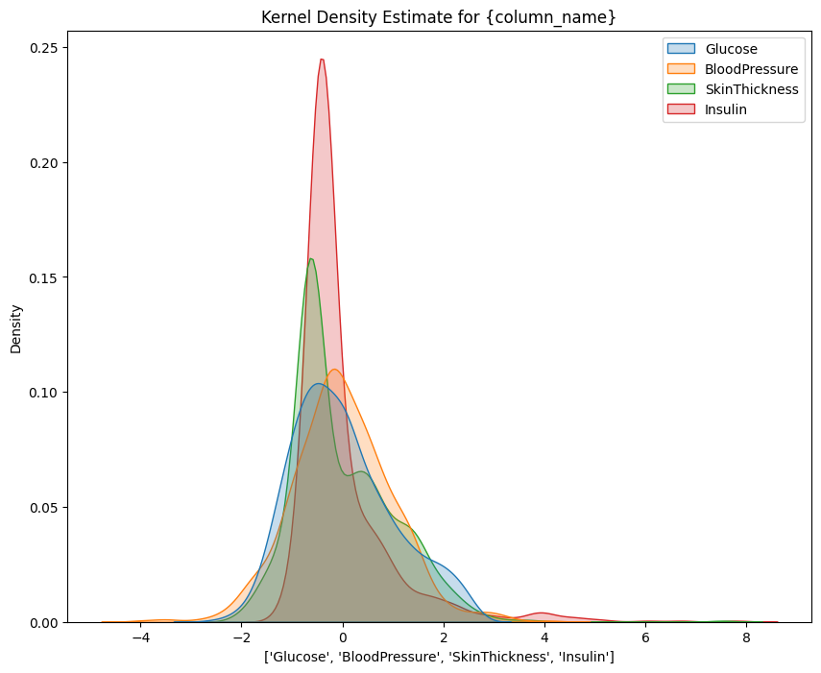
Modelling & Results

Slide 17
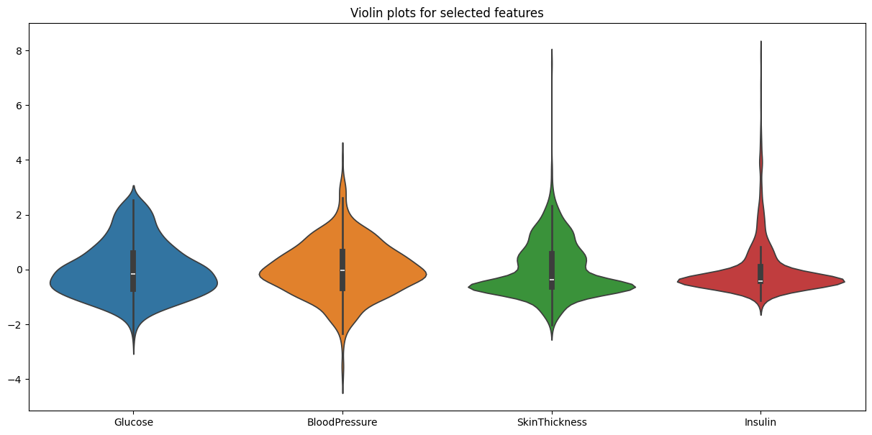
Modelling & Results

Slide 18
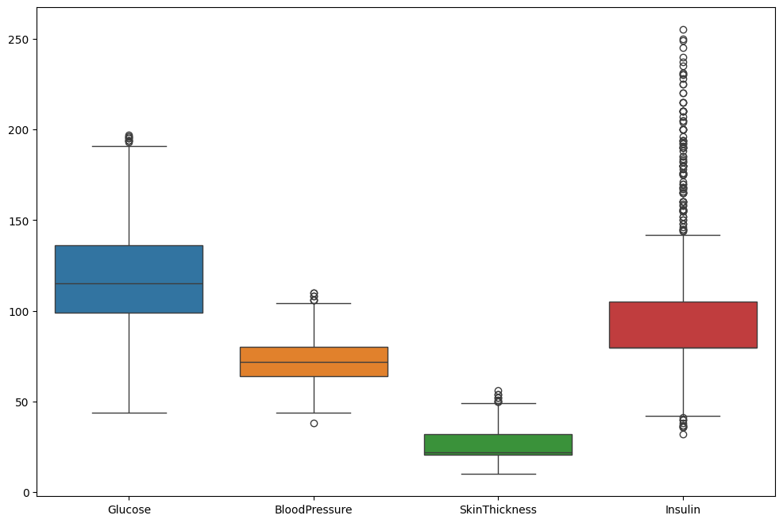
Modelling & Results

Slide 19
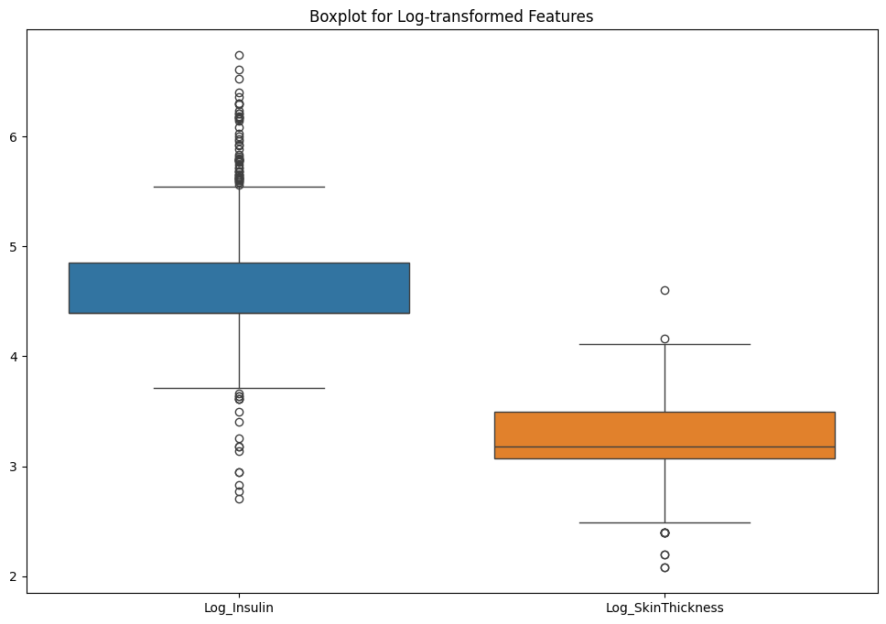
Modelling & Results

Slide 20
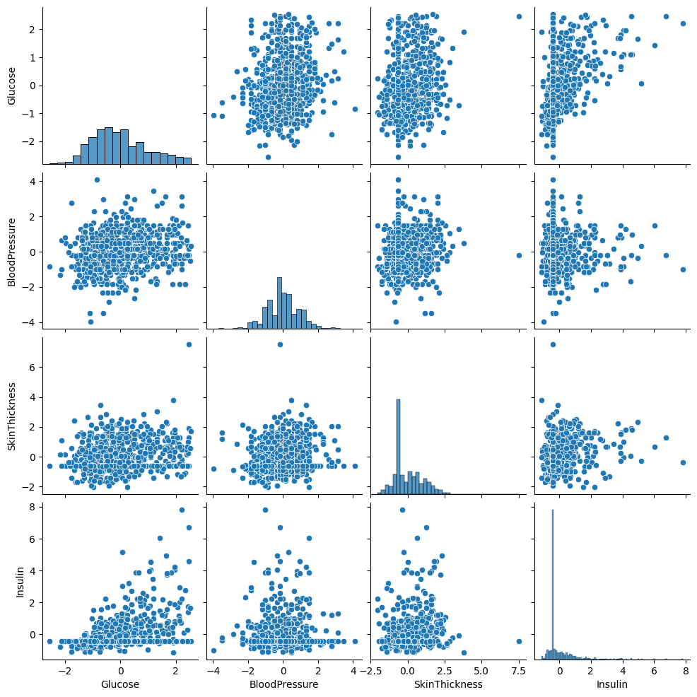
Modelling & Results

Slide 21
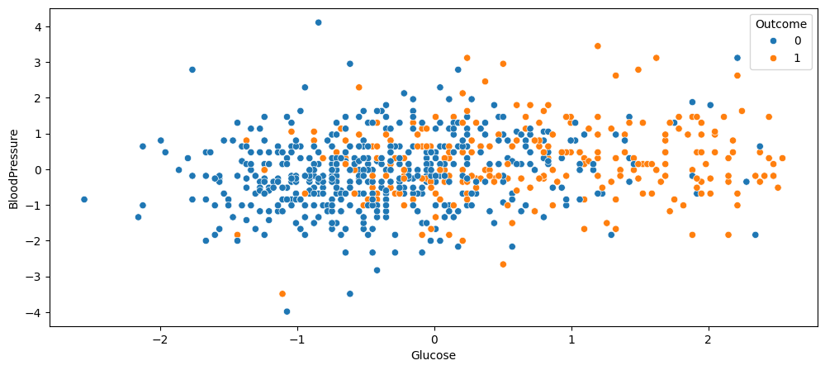
Modelling & Results

Slide 22
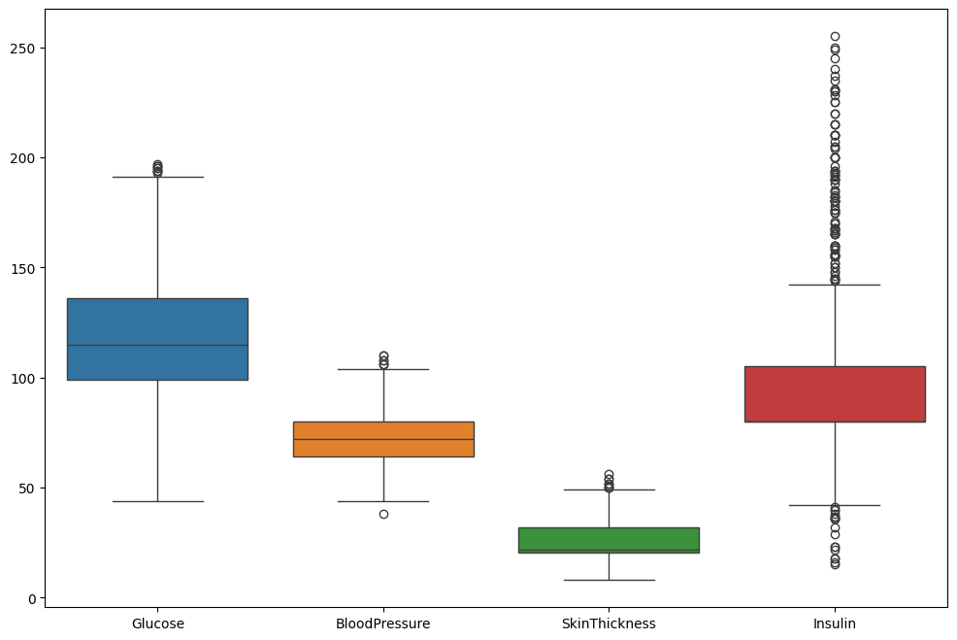
Modelling & Results

Slide 23
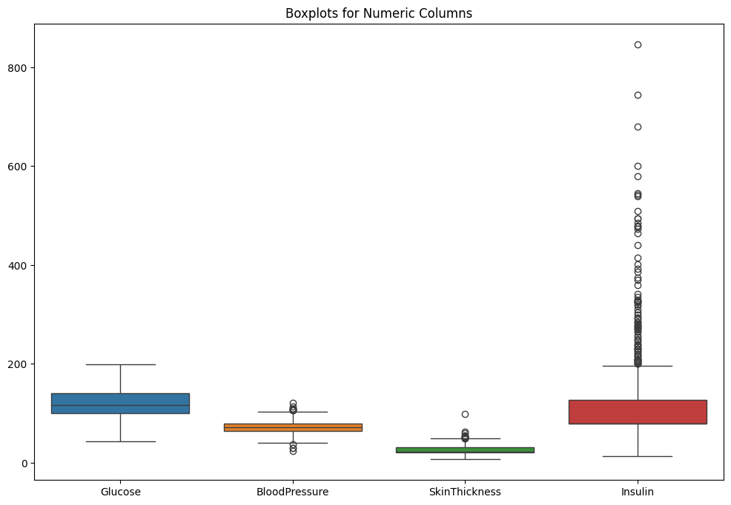
Modelling & Results

Slide 24
Conclusion
The Health Care Prediction project demonstrates the potential of data-driven approaches in transforming the healthcare sector. By accurately predicting outcomes, the project enhances decision-making, reduces diagnostic delays, and improves overall patient care. This predictive system can be scaled to integrate real-time data, making it a valuable tool in future healthcare advancements.

Slide 25
Thank You!
Notes:
Thank You !!

